Slide 1
Noise Margin
B11901027 王仁軒

Slide 2
Procedure
Hspice simulation
Download data
Post-processing done by python
Rotate the curves ccw by 45 degree
Subtract two curves
Find min(local maximum, -local minimum) for SNM, RNM
Find local maximum (or global maximum) for WNM

Slide 3
SNM (corners)
Best at SF, worst at FF
SF
0.647
FF
0.526
TT
0.562
SS
0.634
FS
0.590

Slide 4
SNM (supply voltage)
Roughly linear to VDD
At TT

Slide 5

SNM (width)
Noise margin $↑$ with Wn $↓$ or Wp $↑$
VDD = 1.8 V
Wp = 0.25 um
0.533
Wn = 0.72 um
Wp = 0.30 um
0.562
Wn = 0.62 um
0.564
Wn = 0.82 um
0.560
Wp = 0.35 um
0.569

Slide 6
RNM (corners)
Best at SF, worst at FF
SF
0.350
FF
0.170
TT
0.214
SS
0.283
FS
0.241

Slide 7

RNM (supply voltage)
NM $↓$ with VDD $↓$
At TT

Slide 8
RNM (width)
Noise margin $↑$ with Wn $↓$ or Wp $↑$
VDD = 1.8 V
Wp = 0.24 um
0.196
Wn = 0.72 um
Wp = 0.30 um
0.214
Wn = 0.60 um
0.167
Wn = 0.84 um
0.237
Wp = 0.36 um
0.216

Slide 9
WNM (corners)
Best at FF, worst at FS
SF
0.637
FF
0.794
TT
0.790
SS
0.644
FS
0.628

Slide 10
WNM (supply voltage)
Roughly linear to VDD
At TT

Slide 11

WNM (width)
Noise margin $↑$ with Wn $↓$ or Wp $↑$
VDD = 1.2 V
Wp = 0.25 um
0.472
Wn = 0.72 um
Wp = 0.30 um
0.473
Wn = 0.60 um
0.475
Wn = 0.84 um
0.471
Wp = 0.36 um
0.473

Slide 12
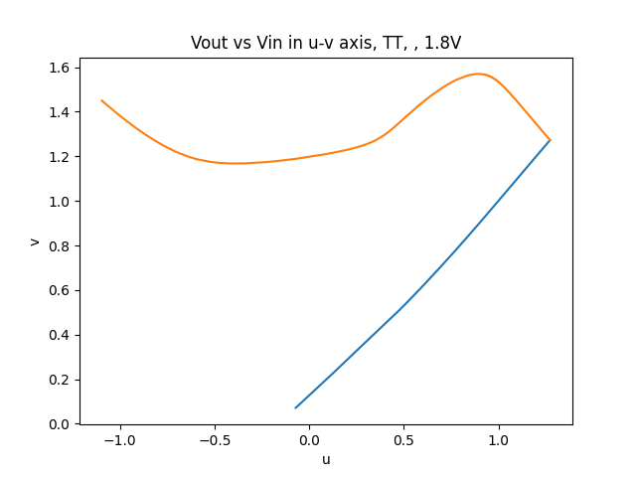
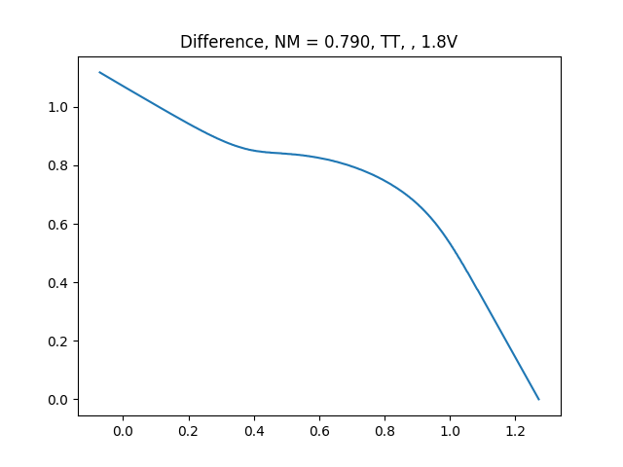
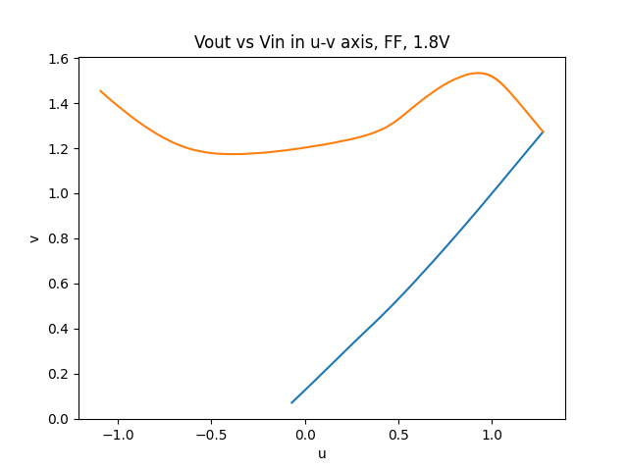
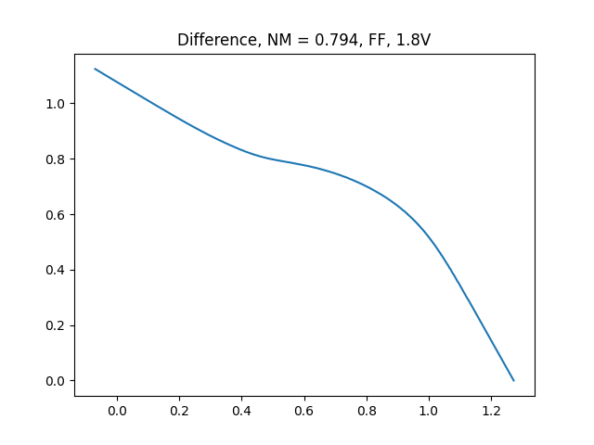


WNM
Some special cases
monotonic
$$→$$
$$→$$

